Slide 1

Practical
PT5053
CASP RCT
Lucy Metcalfe
Senior Lecturer
l.metcalfe@londonmet.ac.uk

Slide 2
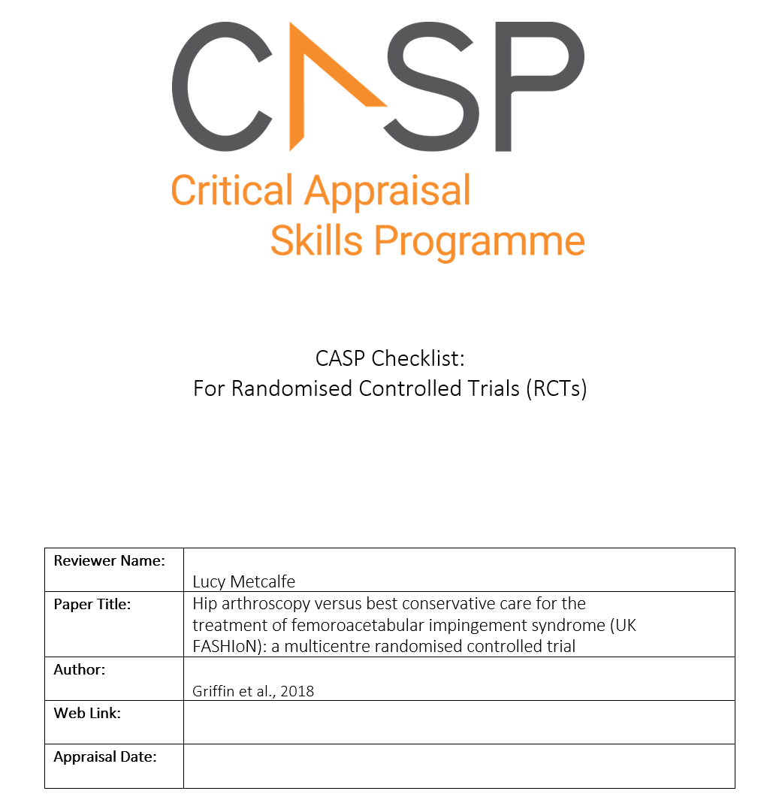
CASP
RCT

Slide 3
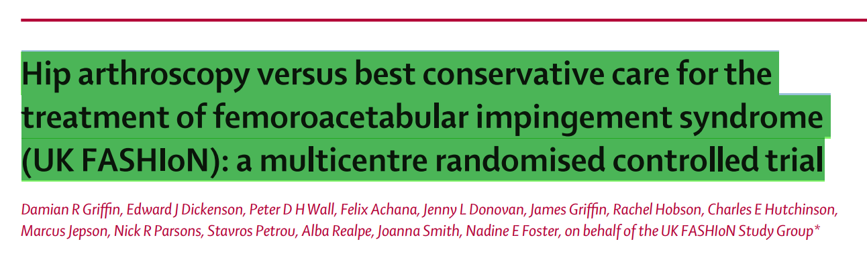
Research article

Slide 4
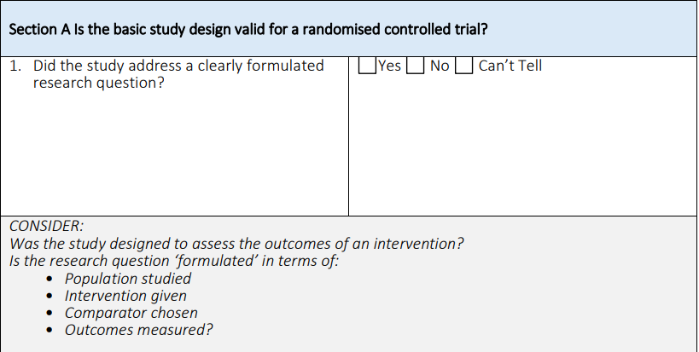
Question 1

Slide 5
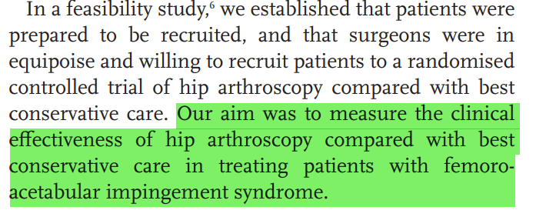
PICO Question?
Population; Intervention; Control; Outcome

Slide 6
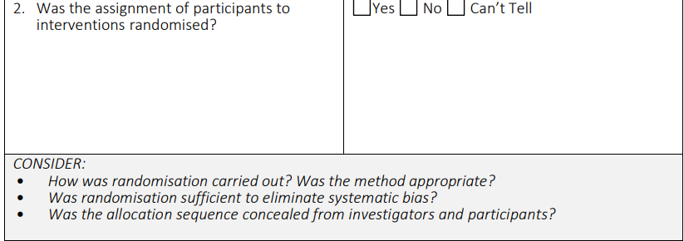
Question 2

Slide 7
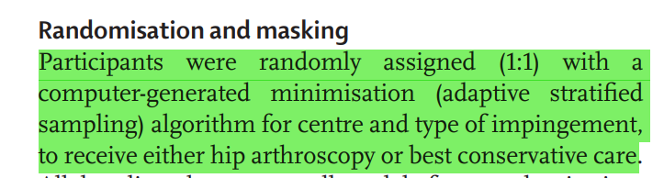

Slide 8
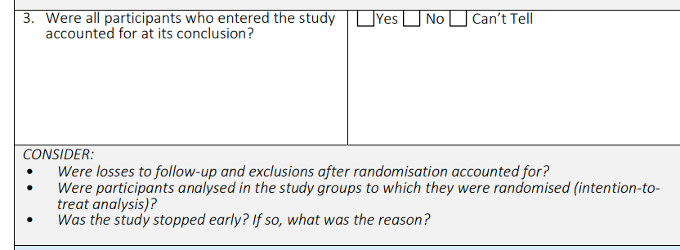
Question 3

Slide 9
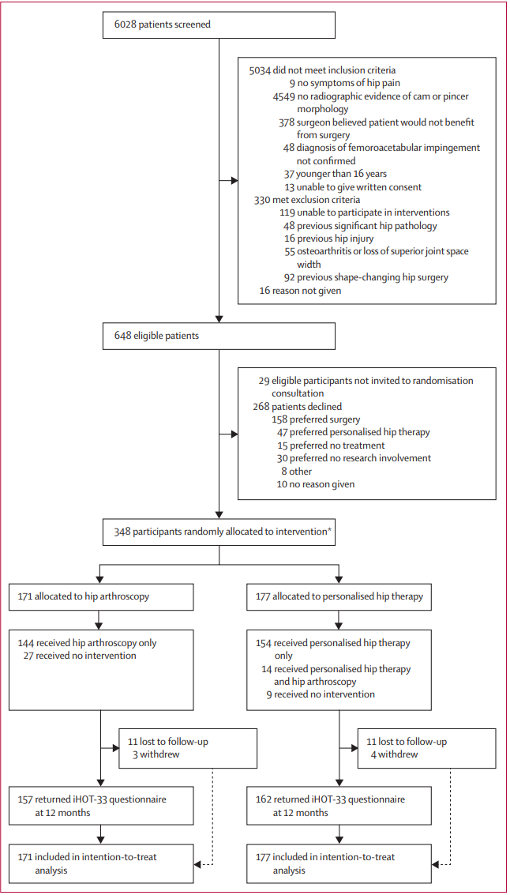











171 = Intervention
177 = control

Slide 10
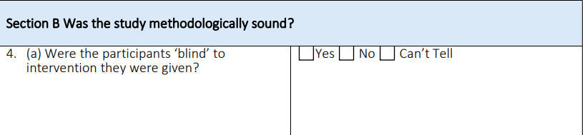
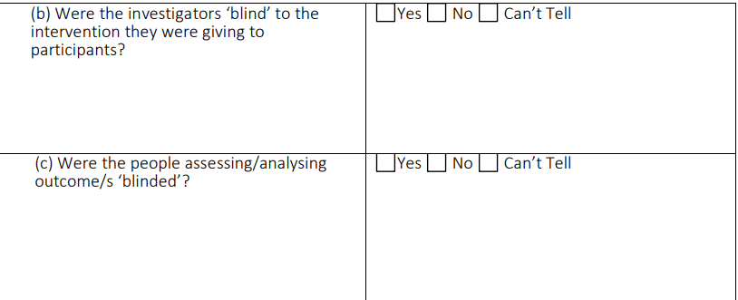
Blinded?
Single
Double
Triple

Slide 11
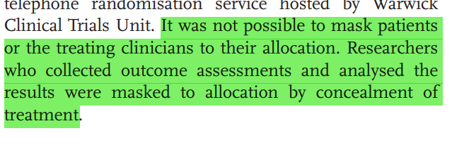
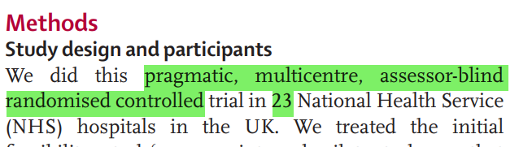
Question 4

Slide 12
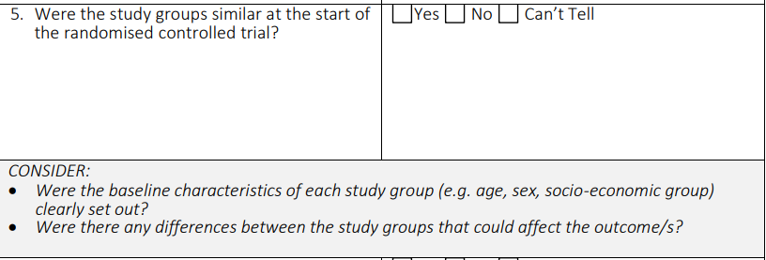
Question 5 – confounding factors

Slide 13
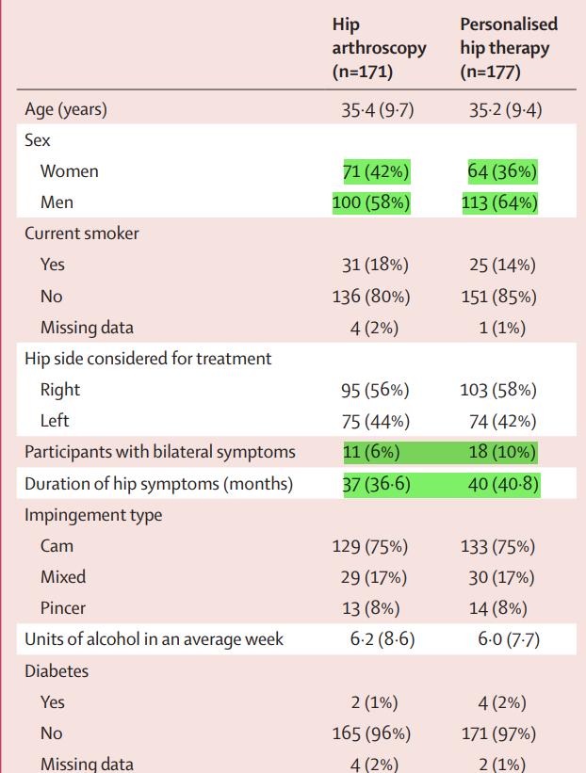
Look for confounding factors between groups

Slide 14
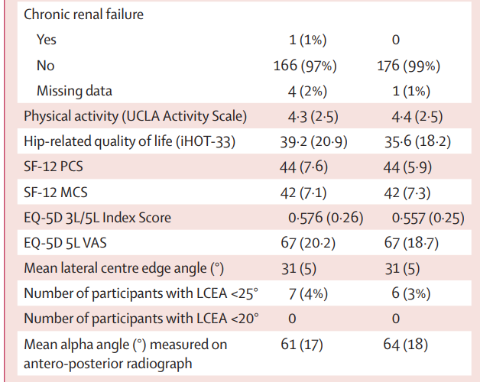
Look for confounding factors between groups

Slide 15
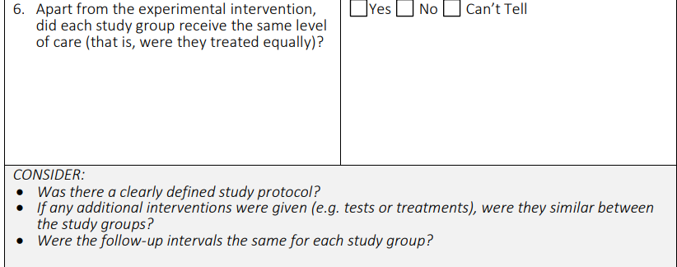
Question 6 – study protocol

Slide 16
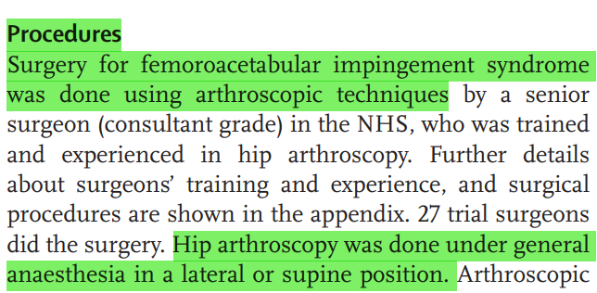
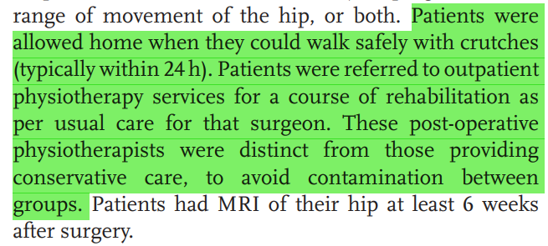
Intervention: Arthroscopic surgery + physio

Slide 17
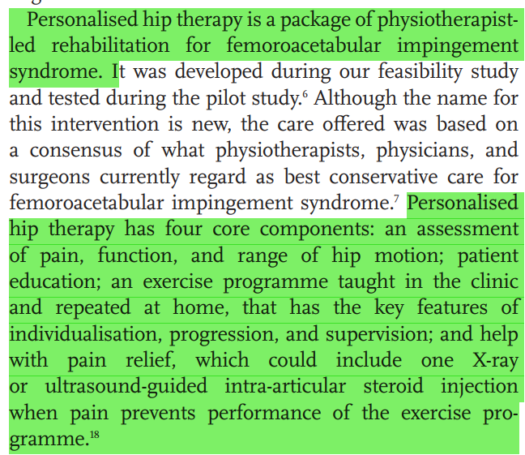
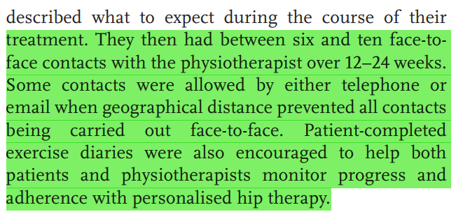
Control – personalized hip therapy
Injection? – did they say how many people had injections?

Slide 18
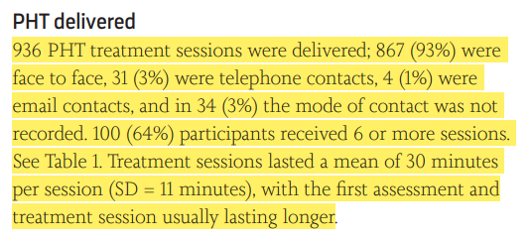
Appendix: only 64% (100 out of 177) had >6 sessions= treatment effect? Factors? ++ critical thinking

Slide 19
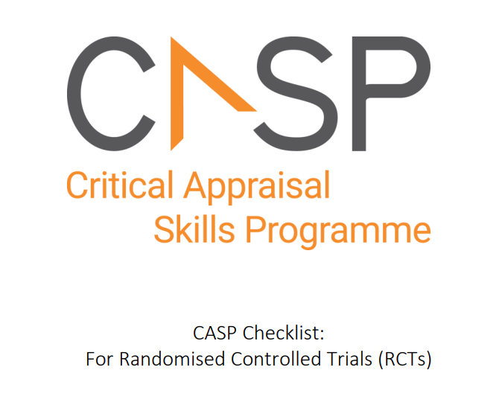
Questions?

